Slide 1
MODERN WIRELESS ENTRY/EXIT
SYSTEM BASED ON RFID AND GSM TECHNOLOGY

Slide 2
PREVIOUS WORK
Keying locks
Password protected systems
Traditional security systems with alarms
Security systems with fingerprint lock.

Slide 3
NOVELTY
Alarm system and automatic switch on/off system is combined to form this project
It is linked with cellular communication
Even when the alarm is set off, the system can communicate with the monitoring center.

Slide 4
OBJECTIVE
Goal: Design and implement a smart wireless entry/exit system
Application : Bank, House and Office
The project uses the GSM technology, RFID. It mainly consists two parts:
Home Security System
Domotics

Slide 5
HARDWARE USED
AVR MICROCONTROLLER(Atmega8)
RFID (EM18) READER
GSM (SIM300) MODULE
16x2 ALPHANUMERIC LCD
PIR SENSOR
ALARM

Slide 6
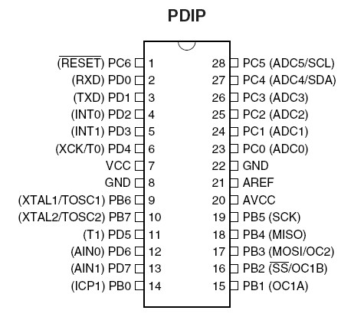
ATmega 8

Slide 7
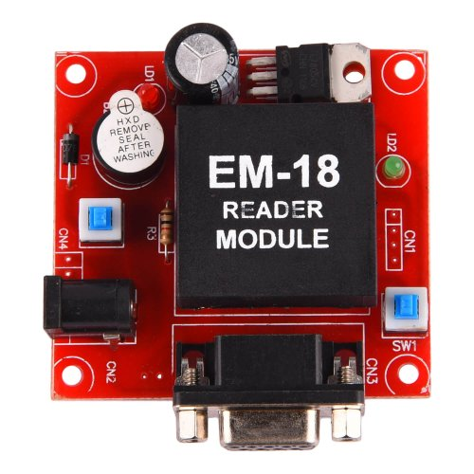
2. RFID (EM18) Reader
RFID - Radio Frequency Identification.
It consists of two parts:
A Reader
Transponders, also known
as Tags.
RFID systems evolved from barcode labels as a means to automatically identify and track products and people.

Slide 8
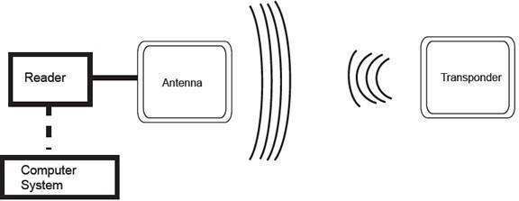
RFID WORKING

Slide 9
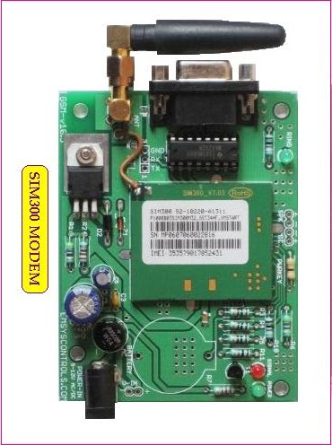
3. GSM (SIM300) MODULE
GSM - Global System for
Mobile communication
Most widely used digital
wireless telephone technology
Single supply voltage 12V
Circuit-switched network optimized for
full duplex voice telephony
It operates at either the 900 MHz frequency band.

Slide 10
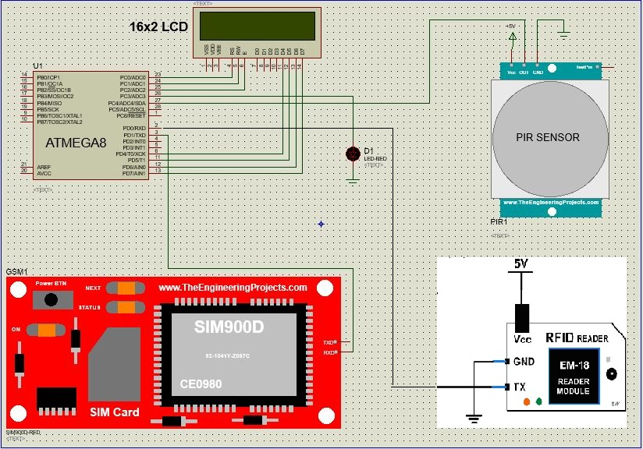
DESIGNED MODEL

Slide 11
Flow Chart of Working Principle
Start
Initialization of
LCD,RFID reader,GSM,Sensors
Check up for RFID tag
RFID tag detected
NO
NO
NO
YES
A
B
C
D

Slide 12
A
B
C
D
Contd..
Tag matched
Sensor ON
NO
Sense
YES
NO
Sensor ON
YES
Sense
SMS sent by GSM
NO
YES
Alarm
Electric Appliances ON
STOP

Slide 13
CONCLUSION
We have implemented a Bank locker security system using passive RFID and GSM.
The GSM based home security system has been designed and tested with the mobile network.
The communication of home is only through the SMS which has been tested with the mobile networks and is working on any mobile network.
The system has tested on the model of smart home and further it will be tested in actual home.
The complexity of the algorithm of the system can be increased by introducing number of sensors to make the energy efficient home.

Slide 14
FUTURE OUTLOOK
Two step verification through OTP
Data Base for Screening process
Motion sensors that know you
Addition of video monitoring

Slide 15
ADVANTAGES
RFID is more secure than lock-key system
Cost efficient and easily available.
Optimum use of Power(Electricity).
Convenience

Slide 16
REFERENCES
Muhammad Ali Mazidi, “Book on AVR microcontroller and Embedded Systems using C”
Gyanendra K Verma, Pawan Tripathi, “A Digital Security System with Door Lock System Using RFID Technology”, International Journal of Computer Applications (IJCA) , Volume 5– No.11, August 2010
Malik Sikandar Hayat Khiyal, Aihab Khan, and Erum Shehzadi. “ SMS Based Wireless Home Appliance Control System (HACS) for Automating Appliances and Security”, Issues in Informing Science and Information Technology. Vol. 9. 2009.
https://en.wikipedia.org
https://www.engineersgarage.com/embedded/avr-microcontroller-projects/rfid-interfacing-circuit

Slide 17
THANK YOU

